Slide 1
Artificial Life
Rui Silva PG25228
Study and implementation of an Artificial Life system.

Slide 2
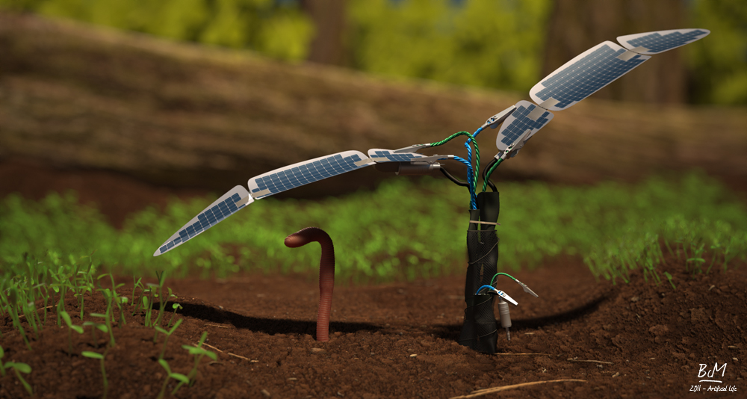
Artificial Life
Studies logic of living systems in artificial environments
Weak Alife
Strong Alife
Notes:
Vida artificial é o nome dado à disciplina que estuda a vida natural através da tentativa de recriar fenômenos biológicos em computadores ou outros meios “artificiais”
From lab created species to digital organisms
Impossivel existir vida fora de soluções quimicas weak alife
"life is a process which can be abstracted away from any particular medium“ – strong alife
Stuxnet funciona efetivamente nas centrífugas de enriquecimento de urânio iranianas possivelmente criado pelos USA

Slide 3
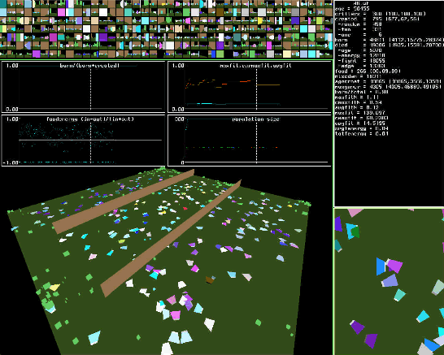
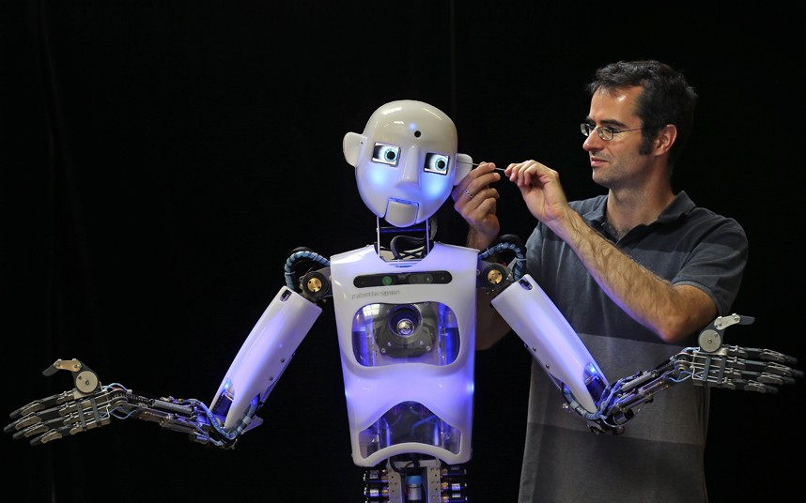
Artificial Life
Soft Alife
PolyWorld
Hard Alife
Robots
Wet Alife
Vacine research

Slide 4
Existing Implementations
PLANTWORLD
Simulate the growth and evolution of disaster prone environments
Mosaic World
Used to investigate the evolution of color vision.

Slide 5
Objectives
Simple framework
Lightweight
Easy to use and configure
Easy to add to and edit

Slide 6


Implementation
Python
Pygame
Tile
Creature
World
Alipy

Slide 7
Tile
Small segment of the world
Different types to represent different lands
Occupied by a single creature at most at any time
Notes:
Refer “moisture” here!! Explain!

Slide 8
Creature
Four static properties: Type, predator, prey and energy
Genome defines the rest
Multiple vision and reprodution types
Color system
Several needs

Slide 9
World
Composed of Tiles
Configurable number and size of tiles
Two types of world space
Defines rules, costs and rewards
Contains list of tiles and creatures

Slide 10
Alipy
Main module of the system
Draws world on screen
Creates the world
Can read parameters from csv file
Creates Population
Random or from csv file
Can save population in csv format
Notes:
Falar das estatisticas

Slide 11
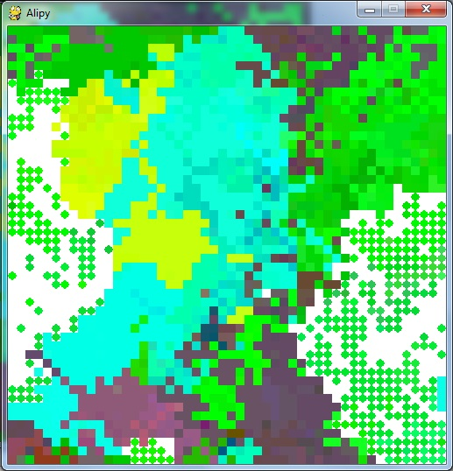
Observations
Creatures evolve under pressure of predator and food supply
Different results every run, but follows same pattern
Can be hard to balance
https://github.com/Skythunder/Alipy
Notes:
Planos futuros…

